Slide 1
EEG Signal Pre-processing - Epoching
Course Instructor
Dr. Annushree Bablani

Slide 5
Goal of the work
To check whether real movements can be compared with imagery movements.
Methods Used:
8 patients implanted with 4x8 or 8x8 grid
1) Active movements –clench – release of hand, stick out tongue, shoulder shrug, say the word “move”
2) Image movements – same as before

Slide 8
Data Epoching
Selecting data epochs
There is no real good reason to select subsets of data epochs. When comparing conditions – performed by creating contrast at the STUDY level (the group analysis interface which may also be used for single-subject analysis) – one may ignore specific data epochs.
Non-overlapping segments
Overlapping segments
Fully overlapping segments
Partially overlapping segments

Slide 9
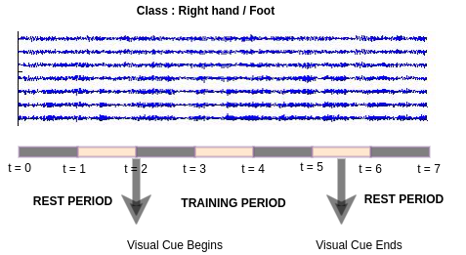
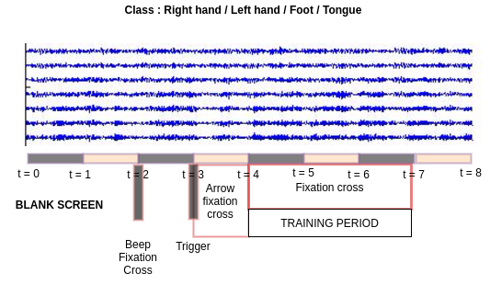
DATASET 1
SINGLE TRIAL
DATASET 2
SINGLE TRIAL

Slide 10
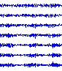
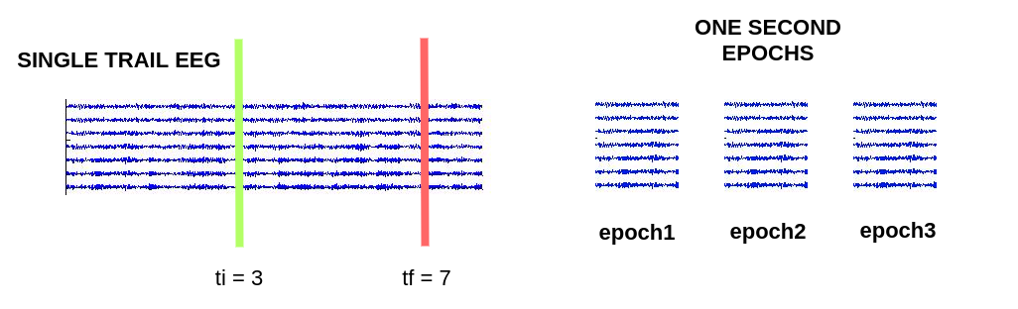
Data Epoching
TRAINING SET(80%)
TEST SET(20%)

Slide 11
Cognitive Workload
Cognitive Workload (CWL) is a demand placed upon humans for mental recourses while performing a task.
Mental resources include working memory, ability to process, etc.
Working memory (WM) is a cognitive system with a limited capacity to hold a small amount of information and process it.

Slide 12
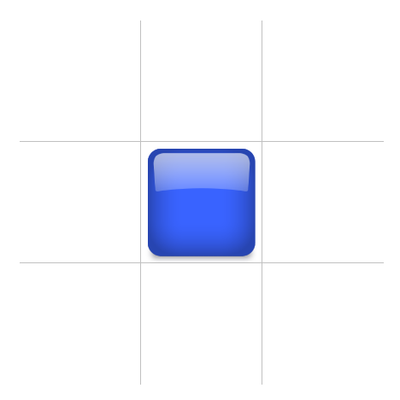
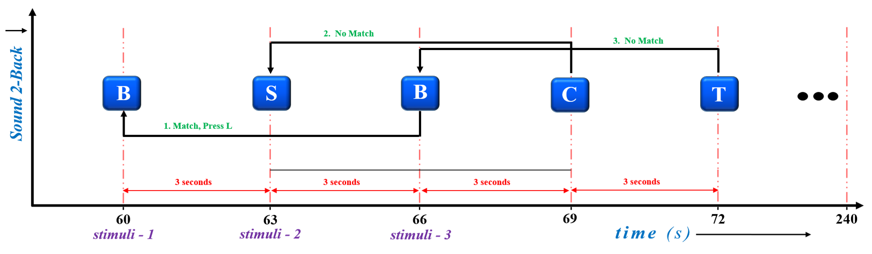
n-Back Task
Sound 2-Back

Slide 13
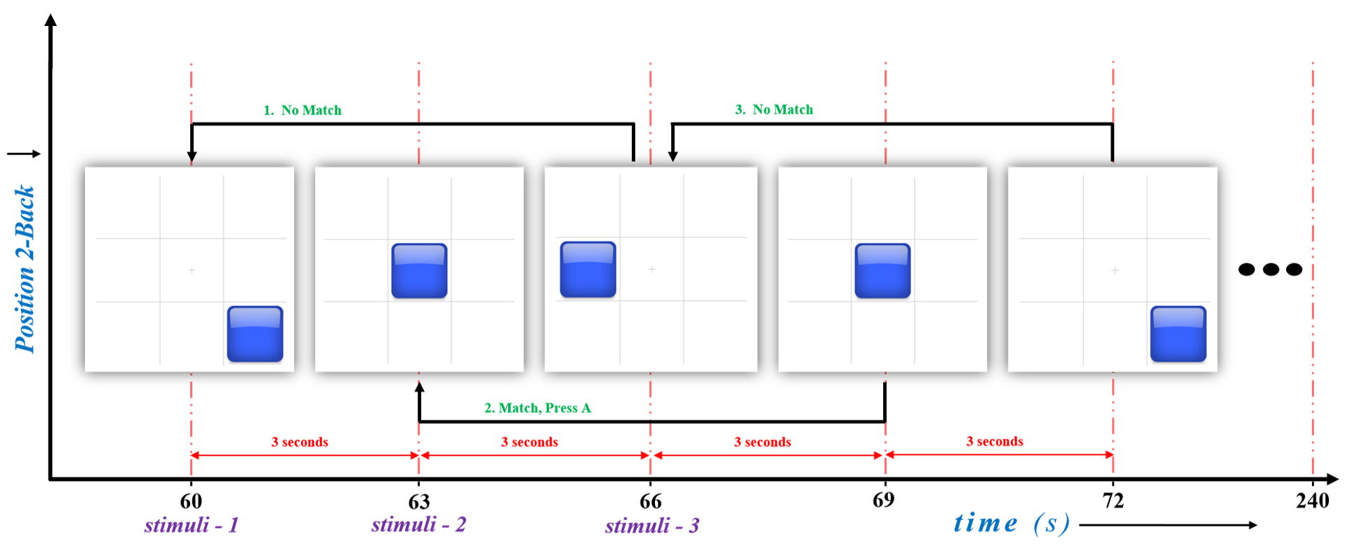
n-Back Task
Position 2-Back

Slide 14
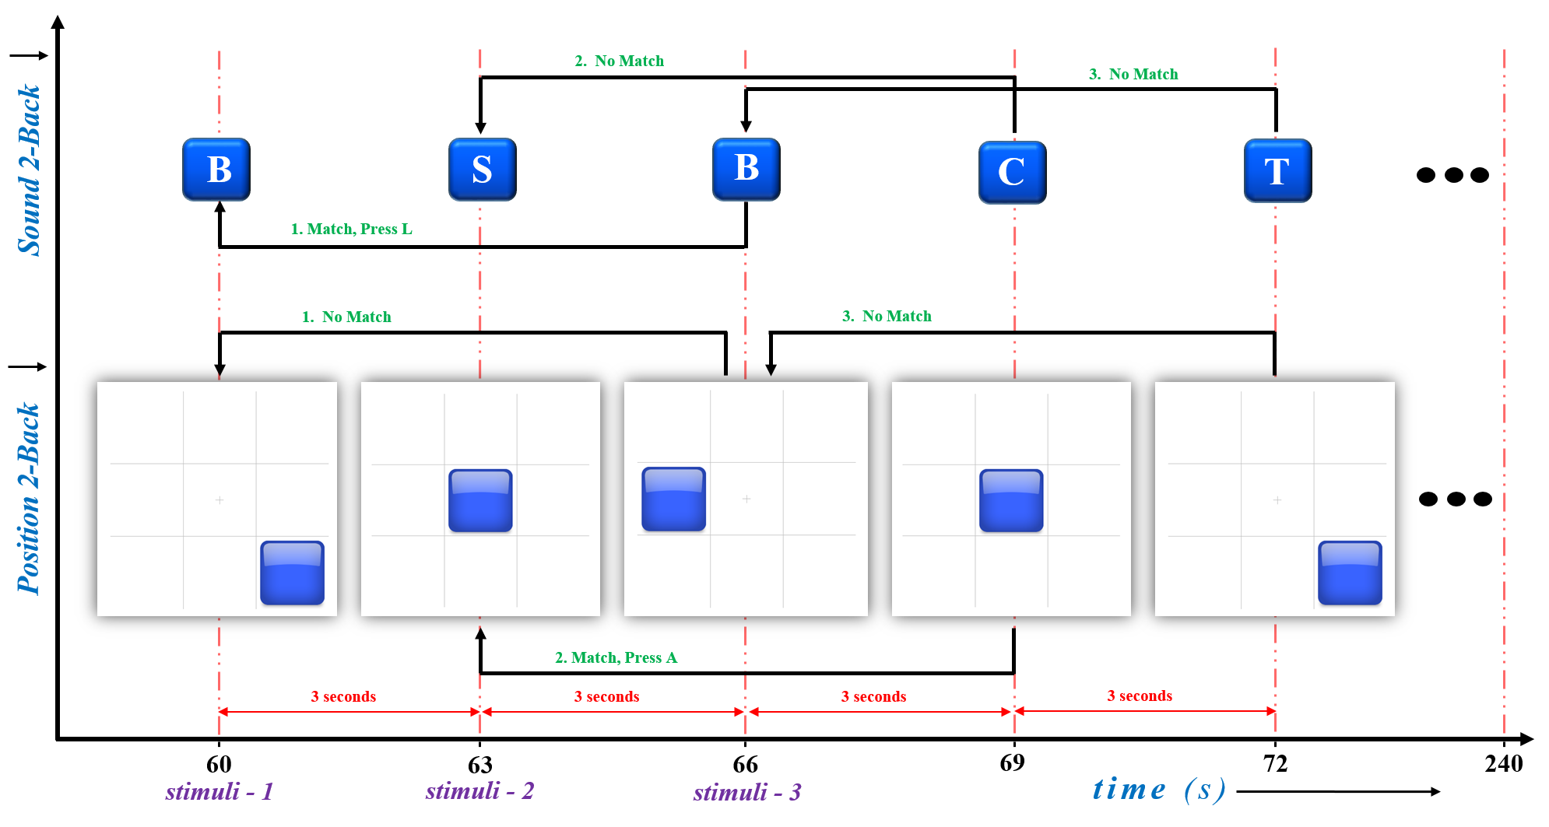
n-Back Task
Sound & Position 2-Back

Slide 15
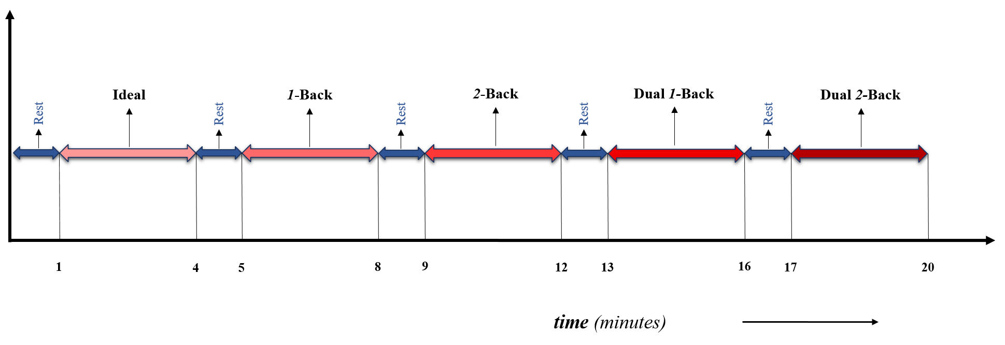
Data Epoching
Task | Cognitive Workload Class | Colour Code depicting Load Variation
Idle | C1
1-Back | C2
2-Back | C3
Dual 1-Back | C4
Dual 2-Back | C5

Slide 16
Thank you!!

